Slide 1
3D COLOUR HISTOGRAMS

Slide 2
PROJECT OVERVIEW

Slide 3
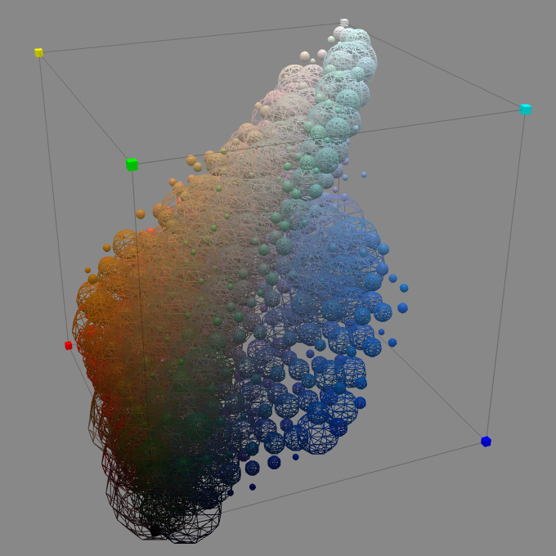
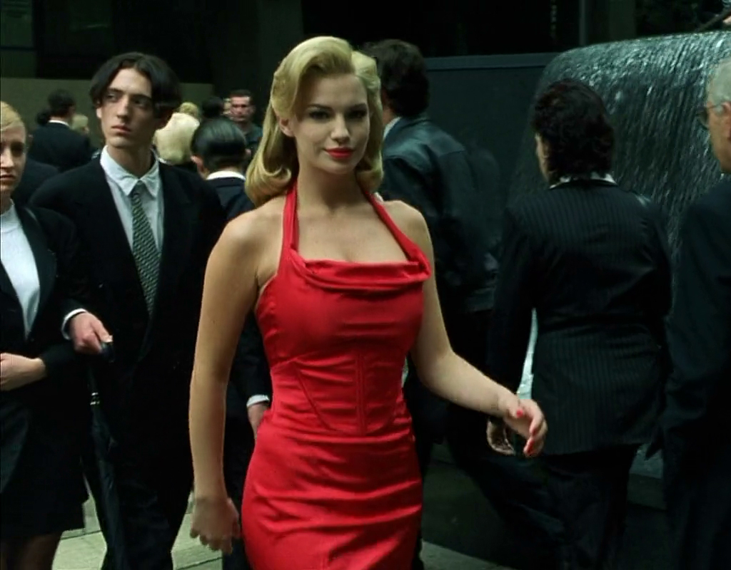
Aims
What are the effects of colour alteration tools on an image’s histogram?
Are these effects useful as a visualisation or tool in image editing software?
3D Colour Histogram
Villarroal (2013)
http://www.gloriouslyvapid.com/vapidwp/wp-content/uploads/2014/03/m003.jpg
Notes:
Visual: 3D colour histogram & colour controls
The question that my project strives to answer is “What are the effects of colour alteration tools (such as brightness, contrast, and saturation), on an image’s histogram?” and “Are these effects useful as a visualisation or tool in image editing software, such as Photoshop?”
I will explain histograms in more depth later, but in this example, three primary colours, red, green, and blue are assigned to the x, y, and z axes
In doing so a cube, capable of containing all possible combinations of these three colour values is created
The colour of each pixel is then plotted in this cube, the size of the plot representing how many pixels have this colour
Graphs such as this are useful to show the distribution of colours within an image
If my histogram is successful, I will explore the possibility of using it as tool of image editing, rather than just a visualisation
For example, if you wanted to make the woman’s red dress in this image to stand out, out could increase the saturation of her dress, while reducing the saturation of the surrounding scene
Rather than drawing an outline around the dress to isolate it, one could use a histogram to select the red tones in the image for alteration
It is also interesting to note that colour histograms are often bi-modal because an image’s background and foreground usually contain different colours: it should therefore be possible to separate the foreground and background of an image using a colour histogram, but this is purely theoretical
Q: Why use histogram? A: This approach would be quicker than selecting spatially and allow greater control over effects such as mood and temperature

Slide 4


Development
My project is platform and language independent but I will implement my project as a website
Web-based applications are more accessible
WebGL and three.js are two JavaScript 3D rendering libraries that I will use

Slide 5
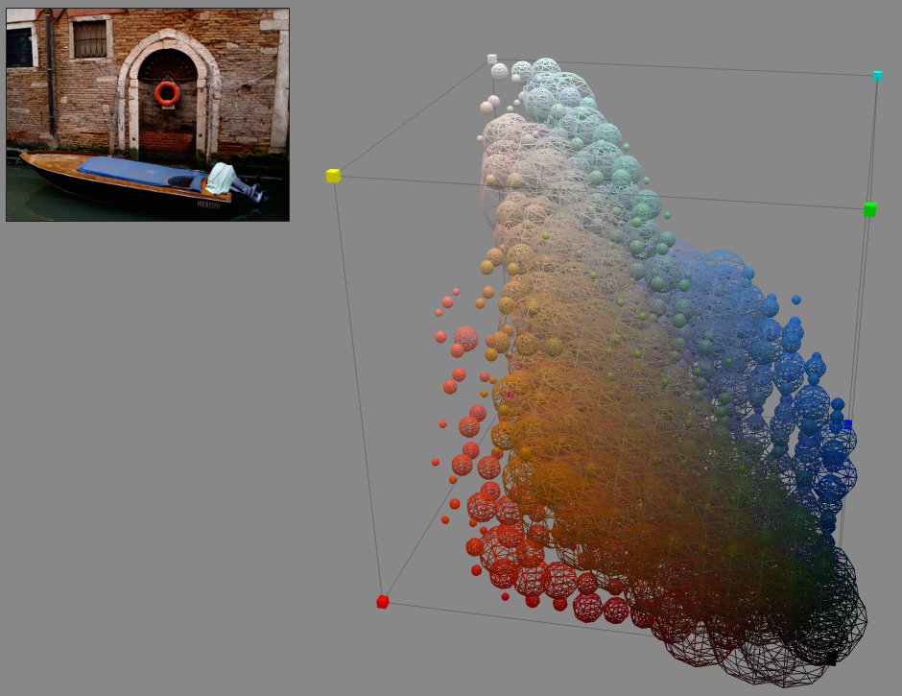
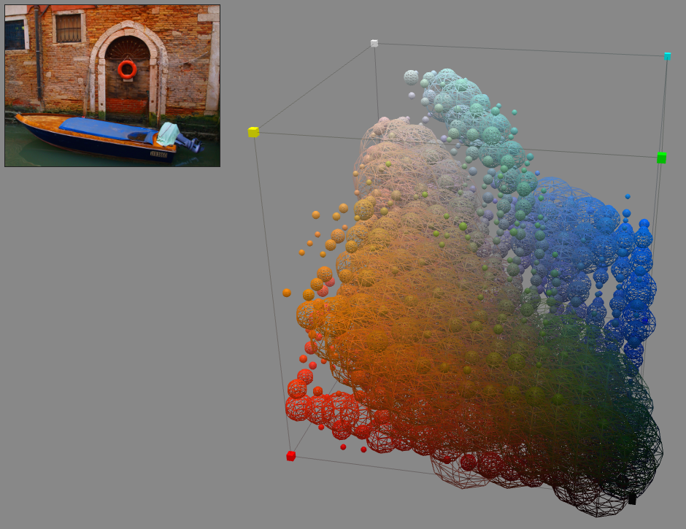
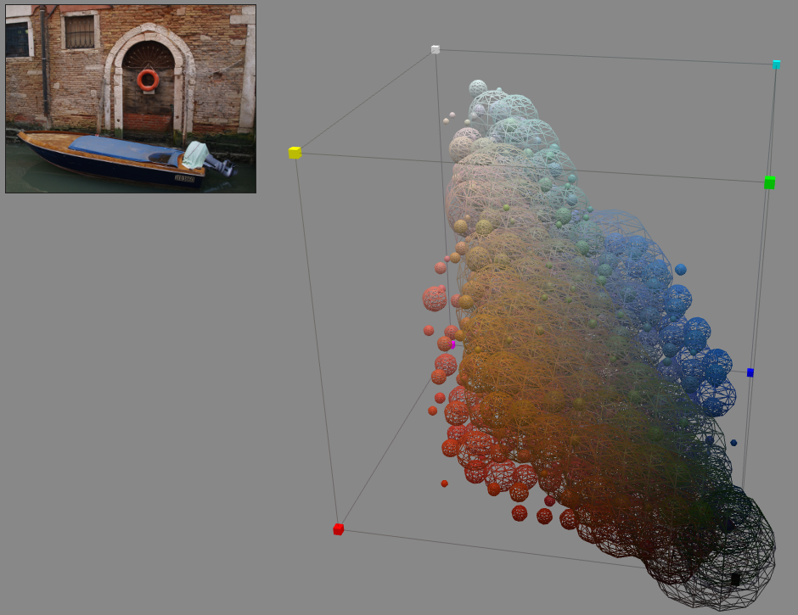
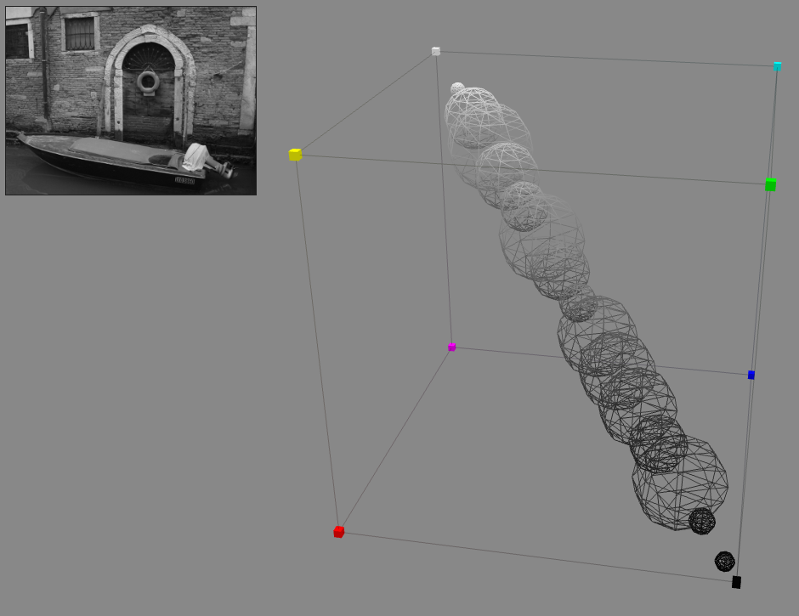
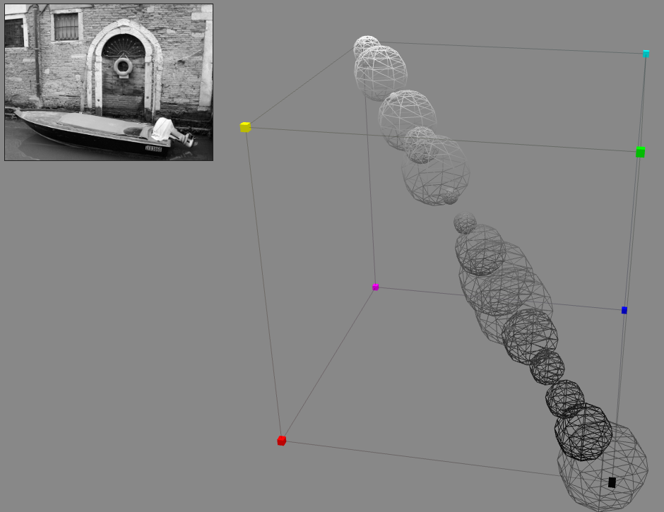
Motivation
Villarroal (2013)

Slide 6
BACKGROUND RESEARCH

Slide 7
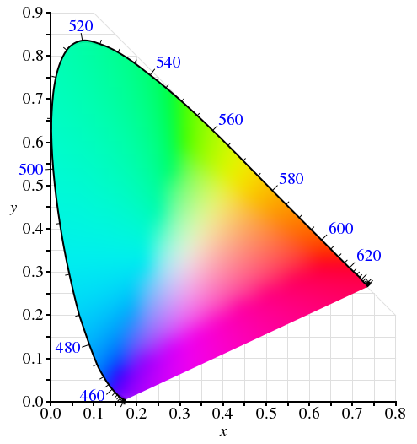
Colour Models & Spaces
Colour model: an abstract model used to describe colours within a coordinate system, independent from physical representation
Colour space: A complete range of colours defined within a colour model
CIE-XYZ Colour Space
https://en.wikipedia.org/wiki/CIE_1931_color_space

Slide 8
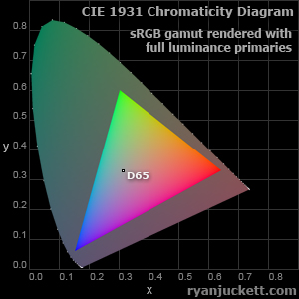
sRGB
Exists within the RGB colour model and is used by most digital monitors
It can be defined within the CIE-XYZ space, allowing transformation between other spaces
However sRGB is limited by it’s size
Also it is not perceptually uniform
Chromaticity | Red | Green | Blue | White point
x | 0.6400 | 0.3000 | 0.1500 | 0.3127
y | 0.3300 | 0.6000 | 0.0600 | 0.3290
Y | 0.2126 | 0.7152 | 0.0722 | 1.000
sRGB’s CIE-XYZ coordinates
Wikipedia (2015)

Slide 9
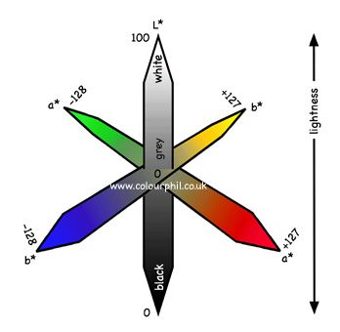
CIE-L*a*b*
Exists within it’s own colour model, defined by luminosity (L), red/green (a) and blue/yellow (b)
It is very large, containing all perceivable colours and more
It is more perceptually uniform than sRGB
However transformations would be required to convert colours into the CIE-L*a*b* space
CIE-L*a*b* Colour Space Diagram
http://www.colourphil.co.uk

Slide 10
Transformations (I)
var_X = X / 95.047
var_Y = Y / 100.000
var_Z = Z / 108.883
if ( var_X > 0.008856 )
var_X = var_X ^ ( 1/3 )
else
var_X = ( 7.787 * var_X ) + ( 16 / 116 )
if ( var_Y > 0.008856 )
var_Y = var_Y ^ ( 1/3 )
else
var_Y = ( 7.787 * var_Y ) + ( 16 / 116 )
if ( var_Z > 0.008856 )
var_Z = var_Z ^ ( 1/3 )
else
var_Z = ( 7.787 * var_Z ) + ( 16 / 116 )
L = ( 116 * var_Y ) – 16
a = 500 * ( var_X - var_Y )
b = 200 * ( var_Y - var_Z )
To convert between two models (CIE-XYZ and CIE-L*a*b*) simply apply the formula
Takes in X, Y, Z coordinates and returns L, a, b coordinates
Irotek Group Ltd. (2014)

Slide 11
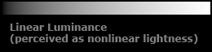
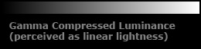
Transformations (II)
One can also convert between two spaces in the RGB model (sRBG and CIE-XYZ):
Apply gamma correction
Derive the transformation matrix from the sRGB primaries and white point
Apply the transformation matrix
CIE-XYZ is used as an intermediate step to convert between various spaces
http://www.ryanjuckett.com/programming/rgb-color-space-conversion/

Slide 12
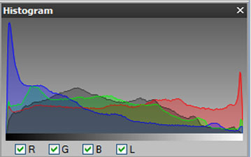
Histograms
2D luminosity and colour histograms plot light levels against their frequency of occurrence
2D histograms are used to check exposure, but 3D colour histograms show the distribution of colour
2D Colour and Luminosity histogram
http://practicalphotographytips.com/Digital-Camera-Basics/color-histograms.html
3D Colour Histogram
Villarroal (2013)

Slide 13
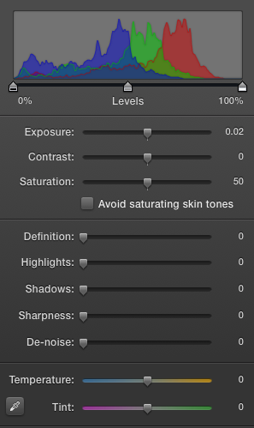

Colour Alterations
Exposure, contrast, and saturation, and highlights and shadows had the most effect on the histogram
Exposure, contrast, and saturation can be applied using algorithms
Highlights and shadows can be applied using the lift/gamma/gain formula:
Xat (2010)
iPhoto’s colour tools and histogram
Apple Inc. (2015)

Slide 14
Technologies
A web-based application will be more accessible and allow me to utilise WebGL and three.js
WebGL is supported by most browsers, uses the HTML5 canvas element, and incorporates OpenGLSL
OpenGLSL enables small programs to be run on the client’s GPU
three.js wraps up WebGL code into a neat and easy to understand package

Slide 15
CURRENT PROGRESS

Slide 16

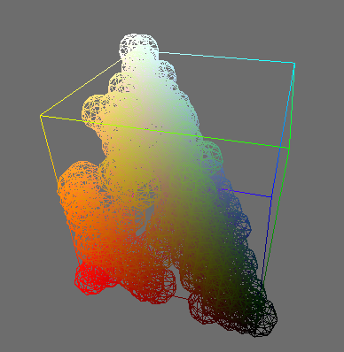
Prototype
I have developed a prototype for my project to accompany my preliminary research
In the coming weeks I will implement the histogram in the CIE-L*a*b* space and create the colour controls

Slide 17
Bibliography
Apple Inc. (2015, March 19). iPhoto. 9.6.1. Apple Inc.
Irotek Group Ltd. (2014). Color conversion math and formulas. Retrieved October 2, 2015 from EasyRGB: http://www.easyrgb.com/index.php?X=MATH&H=07#text7
Villarroal, J. (2013). H3Stogram - 3D Interactive Color Histogram. Retrieved September 27, 2015 from H3Stogram: http://h3stogram.herokuapp.com/
Xat. (2010, January 15). Sequencer color correction. Retrieved November 11, 2015 from Blender Wiki: http://wiki.blender.org/index.php/User:Xat/KeyerNode
Wikipedia (2015, October 20). sRGB. Retrieved December 10, 2015 from Wikipedia: https://en.wikipedia.org/wiki/SRGB

